Slide 1

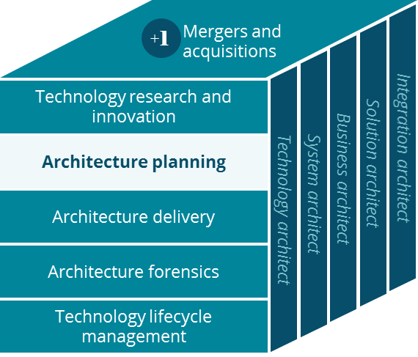
Network Access Business (NAB) Business Canvas
Systems Planning

Slide 2
Business Canvas
Network Access Business (NAB)
Key Partnerships
Key Activities
Value Proposition
Customer Relationships
Customer Segment
TPAs / Brokers
Providers/ hospitals
Development (provider networks)
Sales (network access)
Access provider networks
Discounted price
Members
Plan sponsors
Reprice claims (middleman)
Services inquiries
Providers
Payers
Self-funded employer groups (payers)
Provider billing services
TPAs
Off-shore vendors
EDI Clearing houses
Fast claim turn around
Customer services
Key Resources
Channels
TPAs
Technology infrastructure
Phone
Fax / IVR
e-mail / Mail
Repricing vendors
member /client base
Fast payment
Human resource of IT, CS , sales, & operation mgmt
Website
Fact-to-face
Cost Structure
Revenue Streams
Repricing systems
Stop-loss medical
Operation and Customer services
Vendor services
Percentage of savings
PEPM /PMPM
Stop-loss Premium

